Slide 1
Quick Graphs Using Slope-Intercept Form
Chapter 4
Section 6

Slide 2
Slope-Intercept Form
y=mx+b
Where m is the slope and b is the y-intercept and (x,y) is a point
Examples:
1. Slope: Y-Int:
2. Slope: Y-Int:
3. Slope: Y-Int:
4. Slope: Y-int:

Slide 3
Classwork
Blue book: Pg 133 # 1-12

Slide 4
Graphing Using Slope and Y-Intercept
Steps to Graph using Slope and y-intercept
Write the equation in slope intercept form (y=mx+b)
Find the slope and y-intercept
Plot the point of the y-intercept (0,y)
Graph the slope starting at the point from the y-intercept
Draw a line through the two points

Slide 5
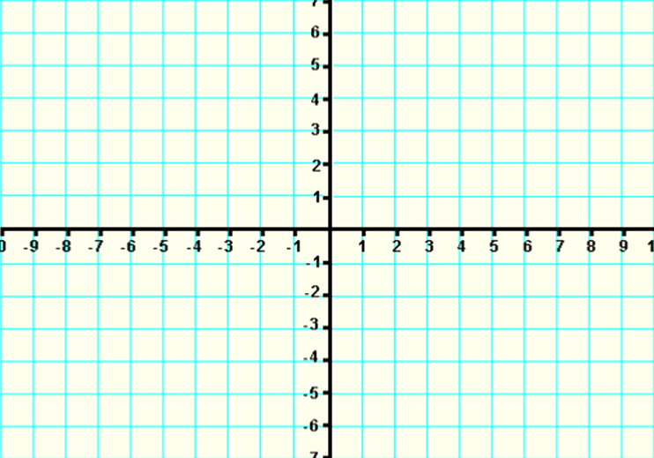
Example:
1.

Slide 6
Example:
2.

Slide 7
Example: Graph Using Slope and y-intercept
3.

Slide 8
Example:
Graph the following using the slope and
the y-intercept:
4. (0,2) 5. (0,-3)

Slide 9
Graphing Using a Point and Slope
Steps:
Plot the point
Use the slope to find a second point
Draw a line through the 2 points

Slide 10
Examples
1. (3, 4), m = -2 2. (-4, 2), m = 1/3

Slide 11
Examples
3. (1, 0), m = -2/3 4. (-4, -3), m = 5/6

Slide 12
Homework
Page 244 # 13-21 odd, 22-30 even

